Slide 1
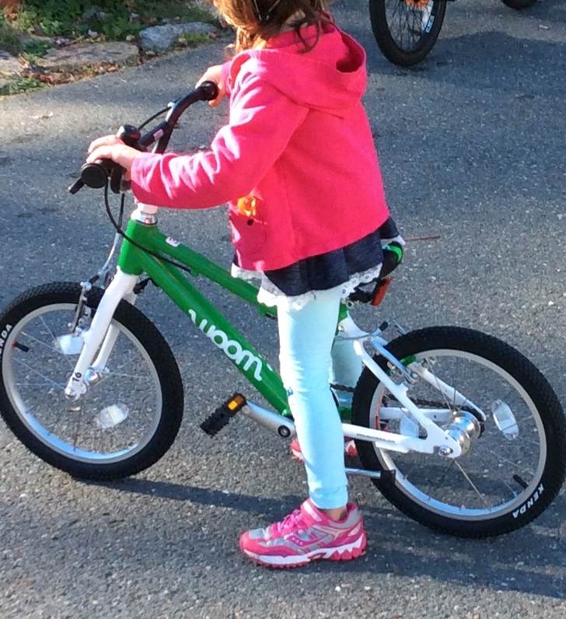

Bike Safety Rodeo
Presented by the Manchester Bike and Ped Committee and the Manchester-Essex Rotary Club
June 16th 3-5pm
Manchester Memorial School
Ages 5-14
Bike and helmet safety checks
Safety tips and training by Manchester Police and Veteran Cyclists
Obstacle Course and bike handling skills
SNACKS!
FREE!!
RSVP to: bikeandpedcommittee@Manchester.ma.us or sign up day of

